Slide 1
User Guide
GOP - Grihasoft Automation Tool – Fuzzy Value Fixer

Slide 2
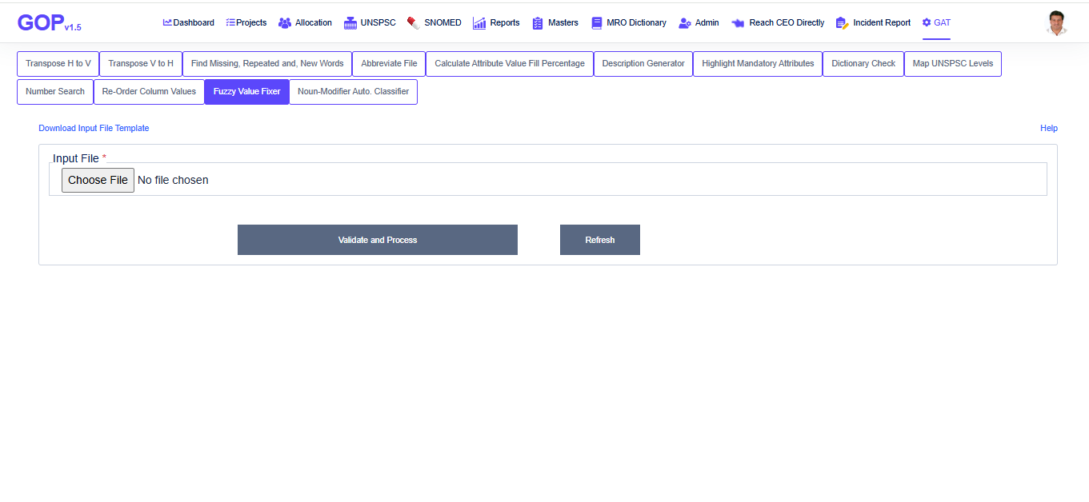
Fuzzy Value Fixer

Slide 3
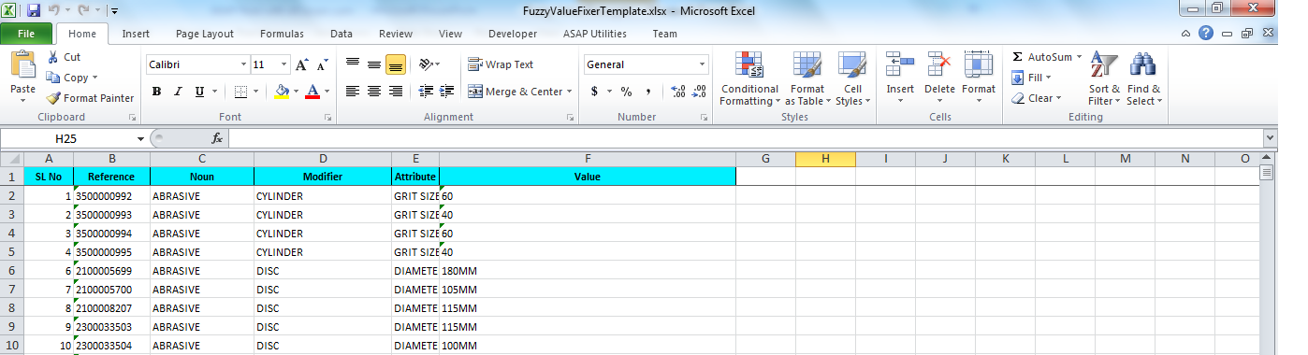
Fuzzy Value Fixer Steps
Step 1: Download Input File Template
Click on Download input file template hyperlink to download the input file.
Step 2: Prepare the input file with valid data
Fill out the necessary input columns in the file and save it.
Input file must contain 2 worksheets.
Below is the example of input file.
Worksheet 1

Slide 4
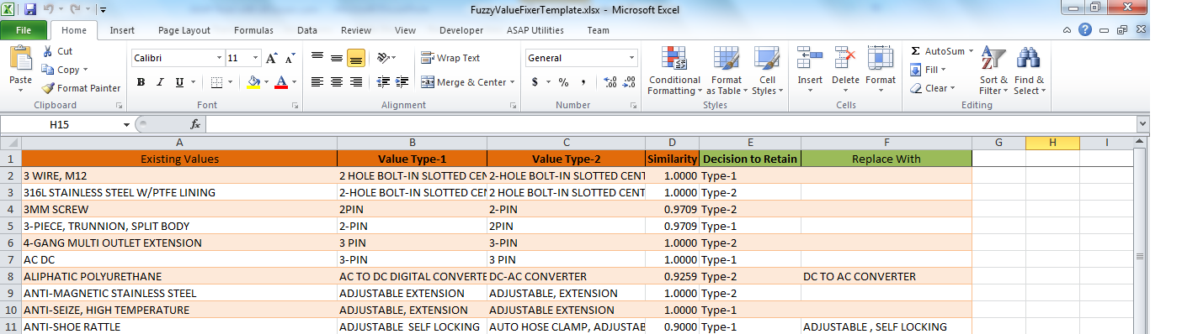
Worksheet 2
Step 3: Select Input file by browsing
Data file prepared in Step 2 will be uploaded to the page through browse option.
Step 4: Validate and process
Click validate and process once the file is uploaded.
Input file must contain all the columns present template file.
Application will check ‘Replace with’ column in worksheet 2, if any value present then it will replace both ‘Value type-1’ and ‘ Value type-2’ columns with value containing in ‘Replace with’ column.
If ‘replace with’ column value is empty then, application will check ‘Decision to retain’ column.
If ‘Decision to retain’ column value is ‘type-1’ then application will replace ‘Value type-2’ text with ‘Value type-1’s value. ‘Value type-1’ text is retained and vice versa.

Slide 5
In second worksheet, if ‘Value-type 1’ and ‘Value-type 2’ columns have same values repeated then application will creates a column ‘Observation’ in worksheet 2 and mark it as conflict.
In second worksheet, Value in 'Decision To Retain' column has to be either 'Type-1' or 'Type-2' or it should be empty.
‘Decision to Retain’ and ‘Replace with’ both column values can not be empty.
Application will create ‘Replacement with value’ column in first worksheet to store replaced values and replaced values are highlighted.
Step 5: Download output file
Once Fuzzy values are fixed successfully, click on download the output file.
An output file will be downloaded in to your local drive.
You can click on close to start uploading new input file.

